Slide 1

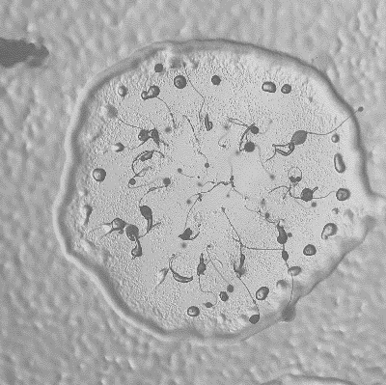
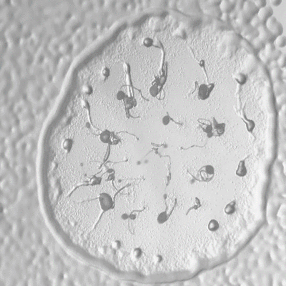
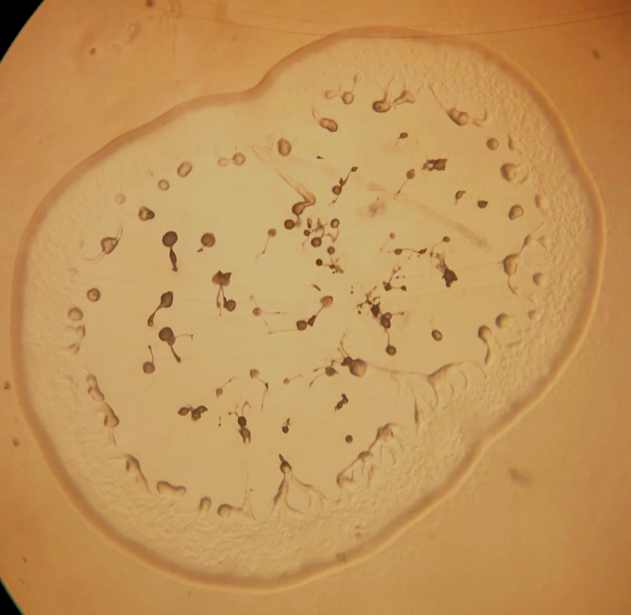
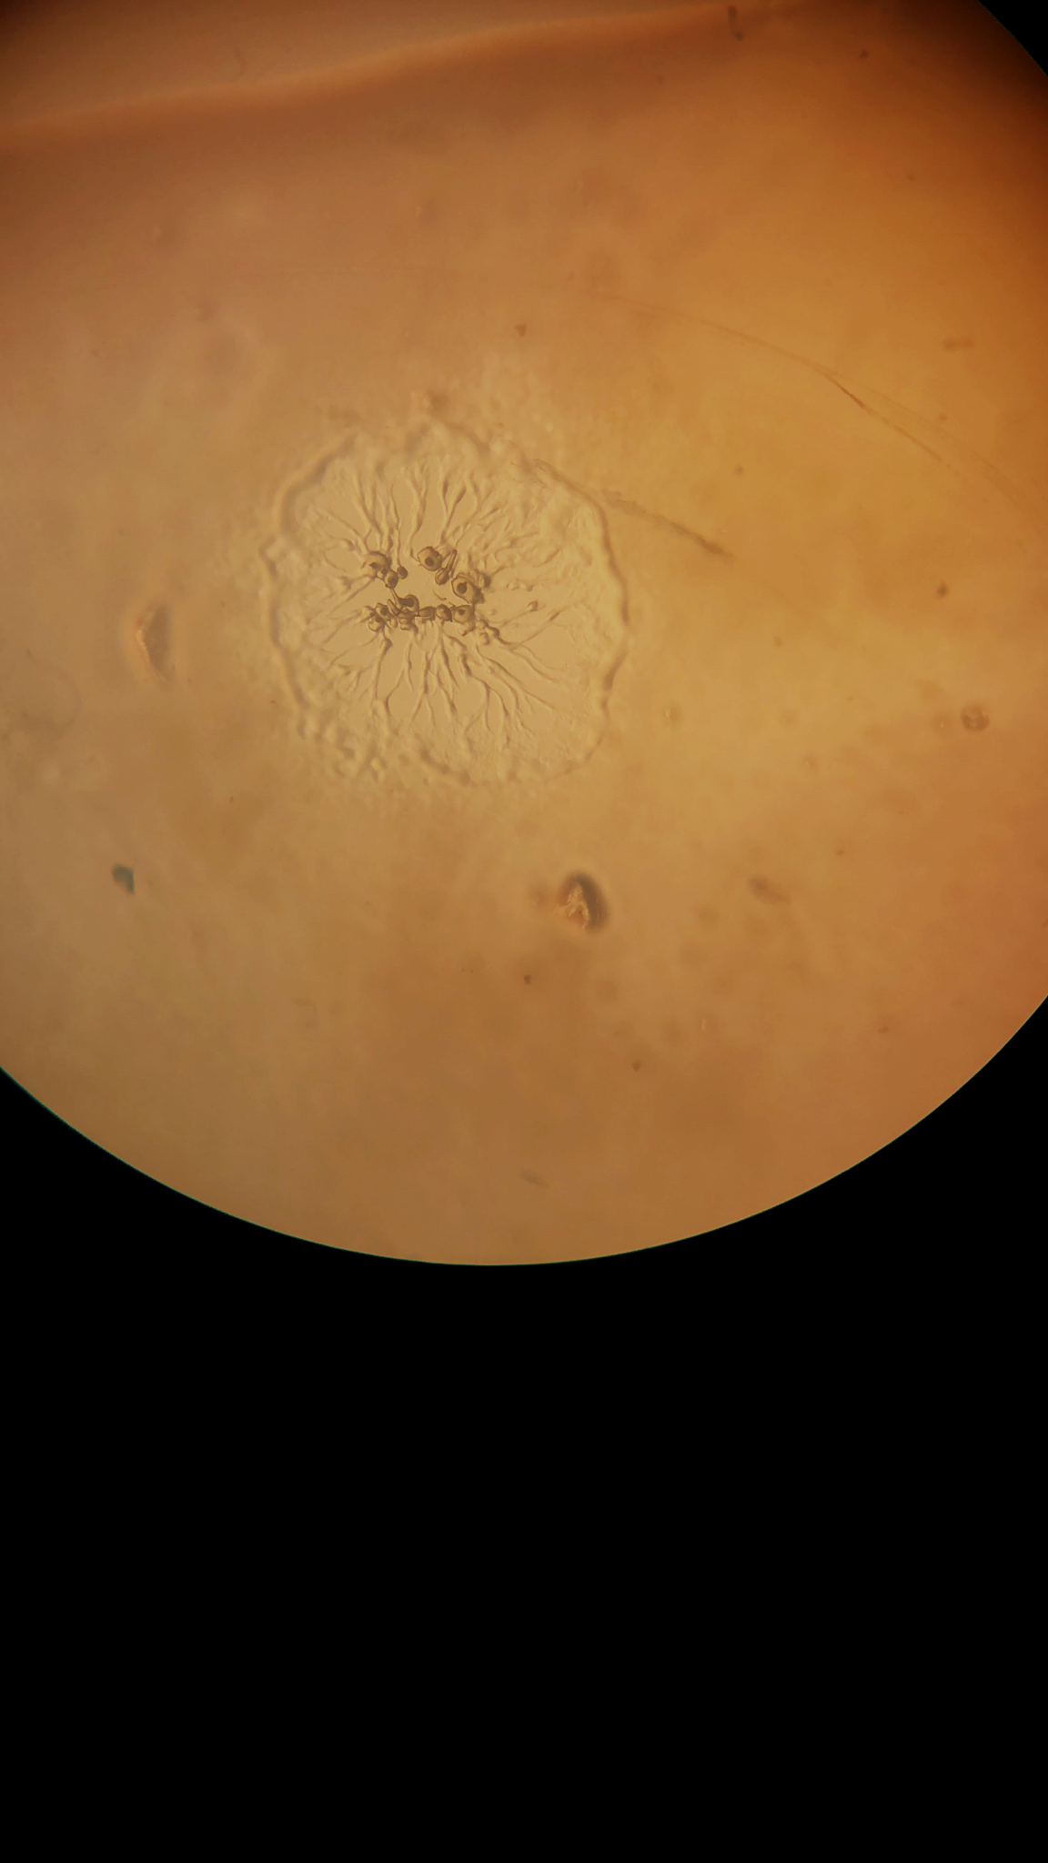
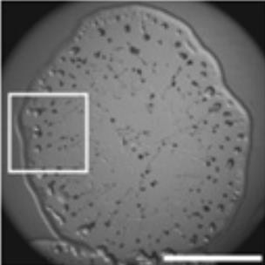
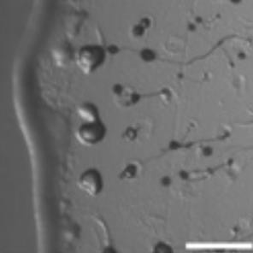
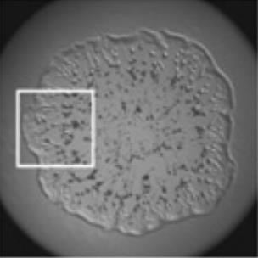
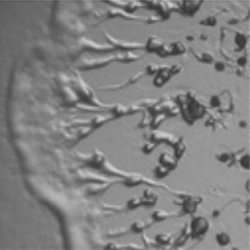
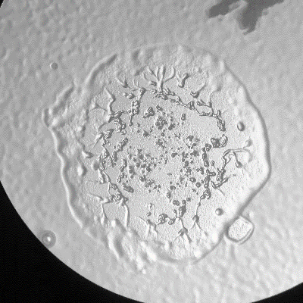
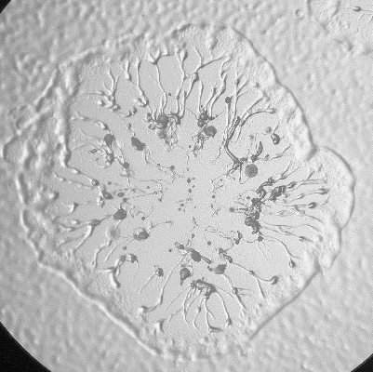
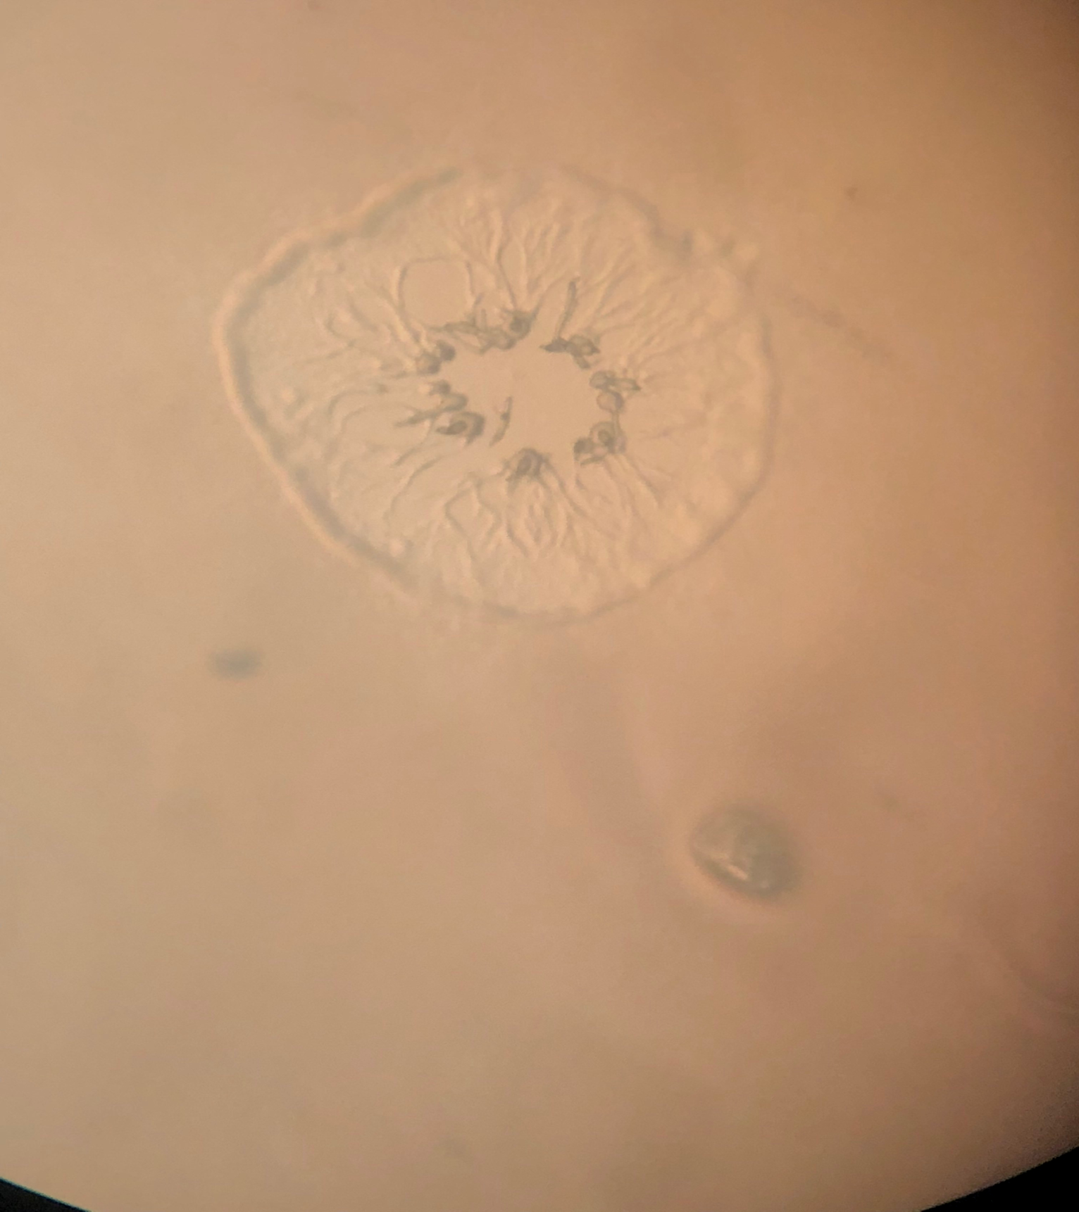
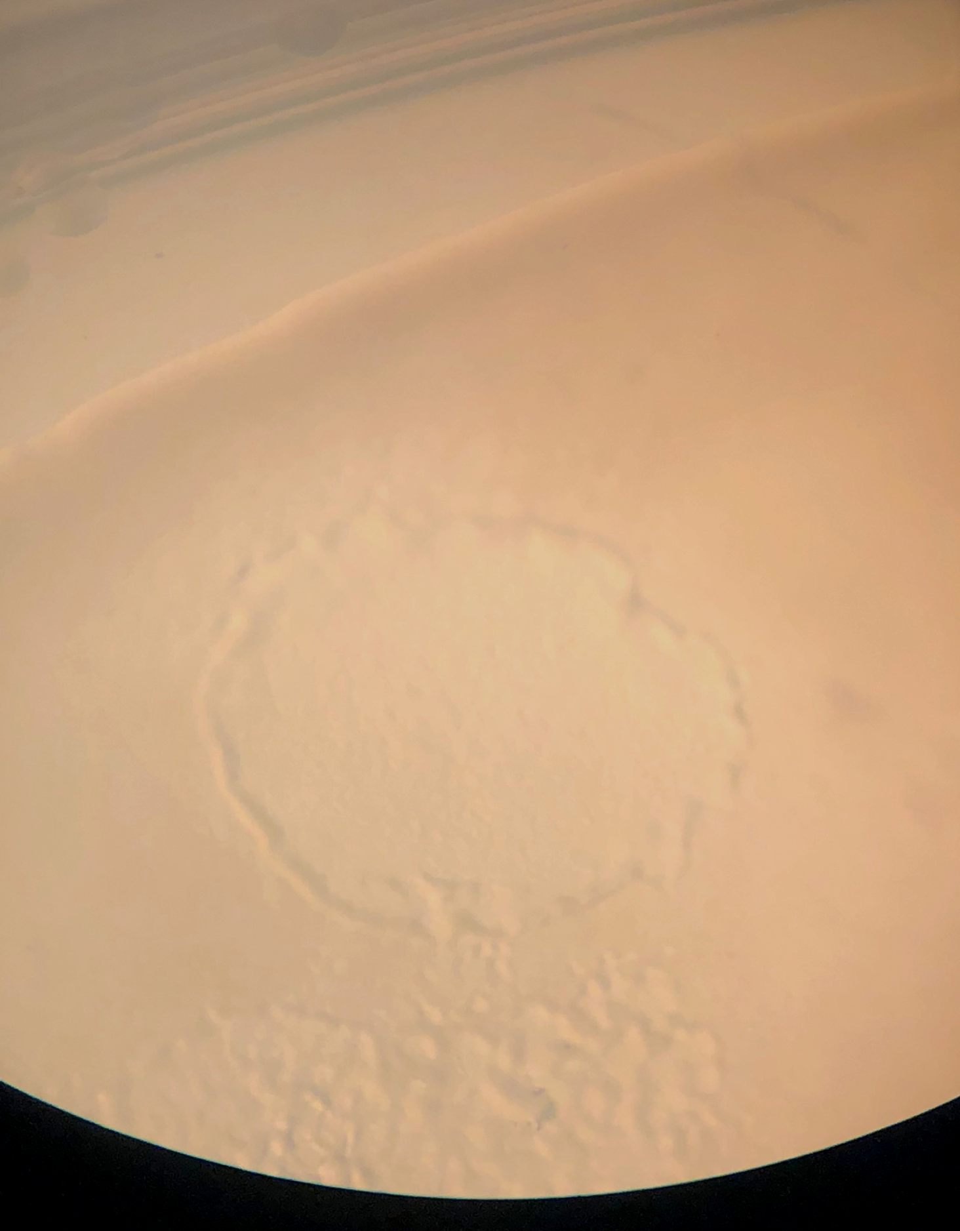
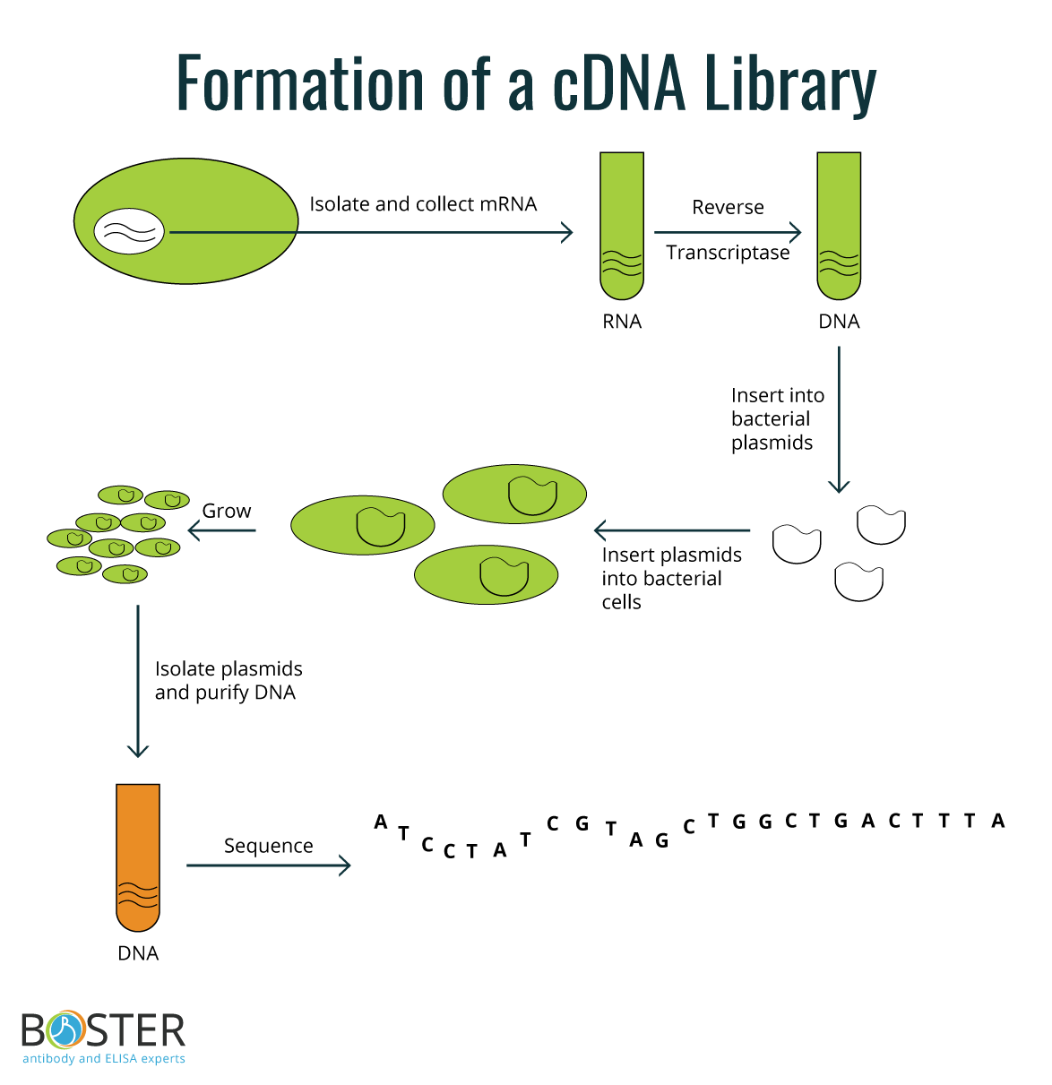
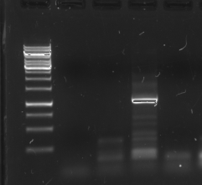
Genetic Screening to Find Novel Regulators of Tumor Suppressor
Homolog Kinase Responsive to Stress B (KrsB)
Emily Fingar, Ali Khan, Swin Ratnayake, Yulia Artemenko
Department of Biological Sciences, SUNY Oswego
Background
Approach and Results
Dictyostelium discoideum is a species of soil-living amoeba belonging to the phylum Amoebozoa (1). It is commonly known as social amoeba.
KrsB is a homolog of tumor suppressors Hippo and MST1/2 and is a negative regulator of cell spreading and substrate attachment (2).
Excessive adhesion of KrsB−null cells reduced directional movement and prolonged the streaming phase of multicellular aggregation (2).
Transform KrsB-null cells with
cDNA library
A
B
A
B
Grow transformed cells on a bacterial lawn
C
D
C
D
Fig 1: A plaque formed by wild-type D. discoideum cells grown on a bacterial lawn. The edge of the colony appears to be smooth.
Fig 2: A plaque formed by D. discoideum cells lacking KrsB grown on a bacterial lawn. The edge of the colony appears to be rough (left) and there is an expansion of the region with streams towards the center.
Pick cells off of plaques with rescued
phenotype (after 4 days)
Fig 4: Plaques formed by colonies of krsB-null cells transformed with 3.5ug cDNA library. (A, B) Sample phenotypes of mutants with rescued plaque morphology showing smooth edges. (C) One plaque with morphology that does not resemble krsB-null or rescue. (D) Sample plaque showing morphology that is typical of krsB-null phenotype.
The active phosphorylated form of KrsB acts to decrease adhesion to the substrate (2).
Our main goal was to express a cDNA library in cells lacking KrsB to find new regulators or effectors of KrsB.
Fig 3: Test to determine whether plaque assay can be used to identify mutants that show rescued morphology compared to krsB-null D. discoideum cells. (A, B) krsB-null cells transformed with empty vector pDM317 (control) and pDM317/KrsB (rescue) were plated on a bacterial lawn at a ratio of 50:1. (A) An example of a rescue plaque with a smooth edge. (B) An example of the krsB-null phenotype with a rough edge and streamer morphology. (C, D) krsB-null cells transformed with an empty vector pDM317 (control). Most plaques showed a rough edge and streamer morphology (C), although a few had aggregationless phenotype (D).
cDNA library is a collection of cloned complementary DNA which contains only exons and is primarily used for cloning and expressing specific genes.
Grow cells and isolate plasmid DNA via miniprep
B
Base pairs
MUTANT 3
Ladder
#1
#2
#3
#4
A
10kb
6kb
3kb
Amplify the cDNA insert via PCR to
check for presence of insert
1kb
https://www.bosterbio.com/protocol-and-troubleshooting/molecular-biology-principle-library-construction
Conclusions and Future Directions
Fig 5: Identification of the cDNA insert for mutant #3. (A) A schematic showing the position of PCR primers in the cDNA library plasmid. (B) Gel shows that the cDNA insert from plasmid DNA isolated from mutant #3 was amplified and produced an ~ 1 kb band.
Plating of cells transformed with the cDNA library yielded 210 plaques on 15 SM/5 plates. Cells from 12 plaques showing a morphology different from krsB-null were collected and grown (Fig. 4). Plasmid DNA was isolated from all 12 mutants.
Although PCR using primers flanking the cDNA insert was performed on plasmids from all 12 mutants, only two mutants showed a single band that could be purified and sequenced. This verifies our method which can work for the identification of the insert, although our mutant collection needs to be expanded.
Two additional transformations of cells with the cDNA library were completed. The first attempt produced only 7 mutants. The second attempt was performed on a larger scale but was determined unsuccessful because of issues with the stock cell line used for the transformation.
Following isolation of additional mutants, we will confirm their phenotypes and identify the cDNA inserts. Each gene will then be further characterized to determine its role in the KrsB pathway.
Sequence cDNA insert
Acknowledgments
References
I would like to thank Dr. Yulia Artemenko of the SUNY Oswego Biological Science Department for the guidance throughout this project.
I would also like to thank Dr. Douglas Robinson from Johns Hopkins University School of Medicine for generously providing us with the cDNA library.
This work was supported by NSF-RUI grant no. 1817378 (to Y.A.)
1. Romeralo, M., et al. (2012). Protist, 163(3), 327-343.
2. Artemenko, Y., et al. (2012). Proceedings of the National Academy of
Sciences, 109(34), 13632-13637.
3. Robinson, D.N. and J.A. Spudich. 2000. Journal of Cell Biology, 150: 823-38.

